Slide 1
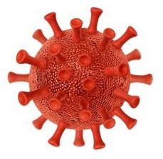
Virus Biology & Evolution
The Case of COVID-19
1.
Introduction to Viruses

Slide 2

What is a virus?
What types of viruses there?
What organisms do these viruses effect?

Slide 3
Learning Objectives
Students should be able to:
Explain what a virus is and how it differs from living organisms.
Describe and provide examples of how viruses affect all varieties of life.

Slide 4
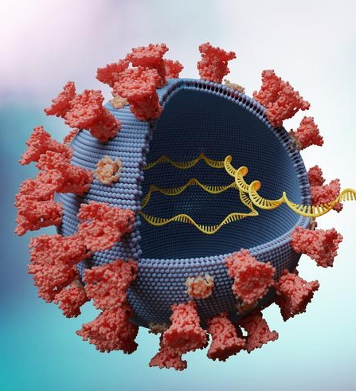
What is a Virus?
Membrane
A virus has 2 components:
Genetic Material
Protective outer layer, made of phospholipids and/or proteins.
DNA / RNA
Membrane Embedded Proteins

Slide 5

Virus Basics: Size
E. coli size for
comparison
Viruses are so small, they are classified as submicroscopic.
A COVID-19 particle is 1/20th the size of an E. coli bacteria.
However, different viruses range across different sizes.
COVID-19 Virus
~100 nm diameter
Influenza
80-120 nm diameter
Norovirus
23-40 nm diameter
Hepatitis A Virus
~27 nm diameter

Slide 6
Virus Basics: Classification
They are classified as non-living as they cannot replicate their own genetic material.
Instead, once infection occurs, viruses rely on a host’s replication machinery to replicate its genetic material.

Slide 7
Virus Basics: Classification
This is a parasitic relationship; the virus uses the host to promote its own fitness, at the expense of the host’s fitness.

Slide 8
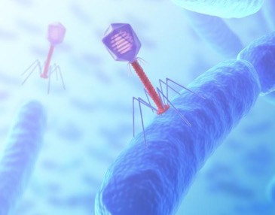
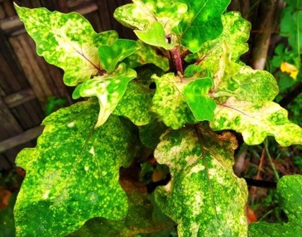
Different Types of Viruses
Viruses can affect bacteria, fungi, plants, and animals.
3 Examples:
image
Covid19
bubble
Plant Virus:
TOBACCO MOSAIC
VIRUS
Animal Virus:
COVID-19
Bacteriophages

Slide 9
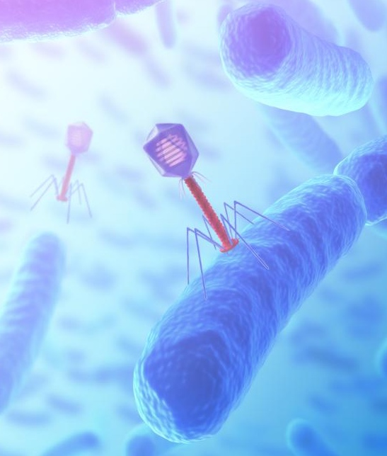
Bacteriophages:
(Bacteria Viruses)
Infect: Bacteria
Goal: Utilize bacterial
cellular machinery to produce more copies of the viral capsules.

Slide 10
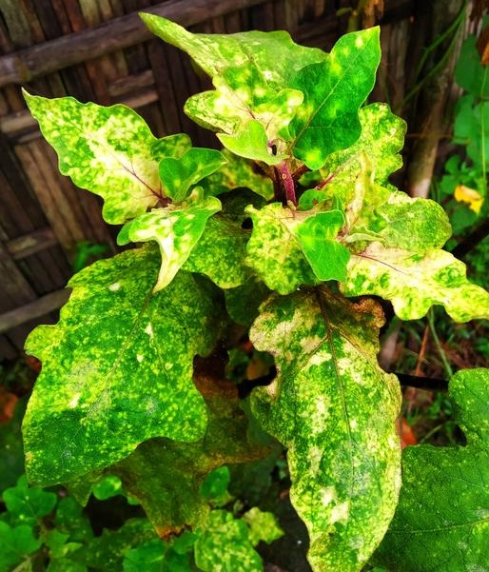
Bacteriophages:
(Bacteria Viruses)
Infect: Plant
Goal: Utilize plant
cellular machinery to produce more copies of the viral capsules.

Slide 11
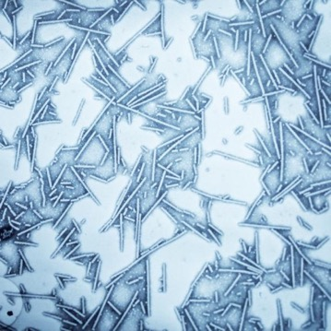
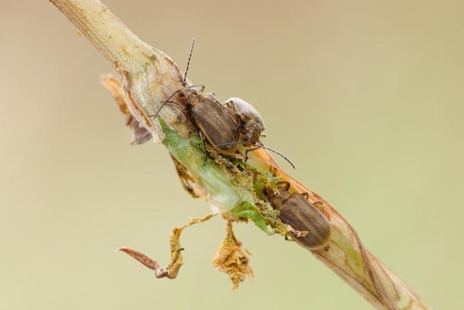
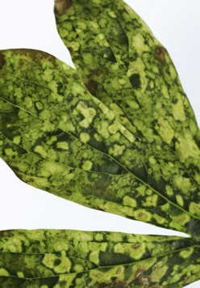
Case Study
Plant Virus: Tobacco Mosaic Virus
Infects Tobacco (& other similar plants), via RNA genetic material
Plant viruses can spread via insects transporting capsules from plant to plant
Virus Diseased Leaves Microscopic Imagery of TMV Insect Carriers of Viruses on Plants

Slide 12
Animal Viruses
Infect: Animals
Goal: Utilize animals
cellular machinery to produce more copies of the viral capsules.

Slide 13
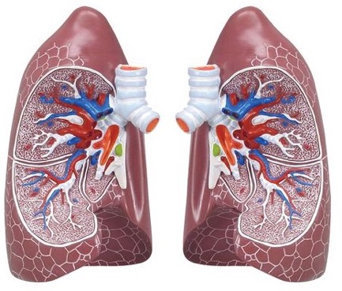
Case Study
Animal Virus: COVID- 19
Infects human cells with RNA genetic material via spike proteins
Commonly enters hosts through the airway (nose and mouth)

Slide 14
Viruses Affecting Humans
COVID
INFLUENZA
RHINOVIRUS
ROTAVIRUS
HUMAN IMMUNODEFICIENCY VIRUS
EBOLA
HUMAN PAPILLOMAVIRUS
MEASLES
CHICKEN POX
SHINGLES
HERPES
NOROVIRUS
HEPATITIS
RESPIRATORY SYNCYTIAL VIRUS
ADENOVIRUS
PARAINFLUENZA (Etcetera, Etcetera….)
Around 270 Viruses affect humans
Not all viruses are pathological; some are advantageous to development within the human virome (subset of microbiome)
However, throughout history there have been many pathological viruses.
Notes:
https://www.cell.com/trends/microbiology/abstract/S0966-842X(22)00175-5

Slide 15
Viruses Affecting Humans
COVID
INFLUENZA
RHINOVIRUS
ROTAVIRUS
HUMAN IMMUNODEFICIENCY VIRUS
EBOLA
HUMAN PAPILLOMAVIRUS
MEASLES
CHICKEN POX
SHINGLES
HERPES
NOROVIRUS
HEPATITIS
RESPIRATORY SYNCYTIAL VIRUS
ADENOVIRUS
PARAINFLUENZA (Etcetera, Etcetera….)
Contagious Viruses:
Some of the most contagious viruses include influenza, rhinovirus (common cold), & measles.
Measles is contagious enough to infect 90% of individuals in close contact with the disease.
Notes:
https://www.cell.com/trends/microbiology/abstract/S0966-842X(22)00175-5

Slide 16
Viruses Affecting Humans
COVID
INFLUENZA
RHINOVIRUS
ROTAVIRUS
HUMAN IMMUNODEFICIENCY VIRUS
EBOLA
HUMAN PAPILLOMAVIRUS
MEASLES
CHICKEN POX
SHINGLES
HERPES
NOROVIRUS
HEPATITIS
RESPIRATORY SYNCYTIAL VIRUS
ADENOVIRUS
PARAINFLUENZA (Etcetera, Etcetera….)
Deadliest Viruses:
Some of the deadliest viruses known to humans include:
Marburg ~ 50% mortality
Ebola ~ 50% mortality
Smallpox ~ 30% mortality
Notes:
https://www.cell.com/trends/microbiology/abstract/S0966-842X(22)00175-5

Slide 17
COVID
COVID
INFLUENZA
RHINOVIRUS
ROTAVIRUS
HUMAN IMMUNODEFICIENCY VIRUS
EBOLA
HUMAN PAPILLOMAVIRUS
MEASLES
CHICKEN POX
SHINGLES
HERPES
NOROVIRUS
HEPATITIS
RESPIRATORY SYNCYTIAL VIRUS
ADENOVIRUS
PARAINFLUENZA (Etcetera, Etcetera….)
Each virus has a unique
mechanism of infection,
and this unit will explore
the COVID-19 virus
as a case study.

Slide 18
Next Time…
Exploration into the life cycle of a virus
Overview of the virus life cycle, including entry, replication and shedding of new viral capsules

Slide 19
Virus Biology & Evolution
The Case of COVID-19
2.
Life Cycle of a Virus

Slide 20
How does a virus enter a host?
Once entered, what happens?

Slide 21
Learning Objectives
Students should be able to:
Be able to explain and sketch entry of viral genetic material into the host cell
Provide an overview of how viral genetic material uses host cell’s machinery for replication.
Describe the similarities and differences for various mechanisms of viral shedding (and in what circumstances they apply).

Slide 22
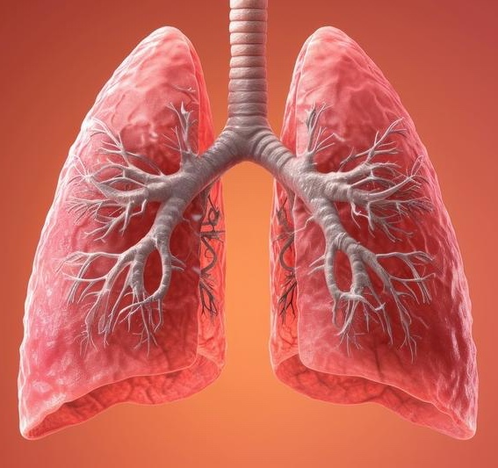
Viral Infection
Although viral infection
can vary depending on the
specific virus, many (along
with COVID-19) enter
a host via respiration.

Slide 23
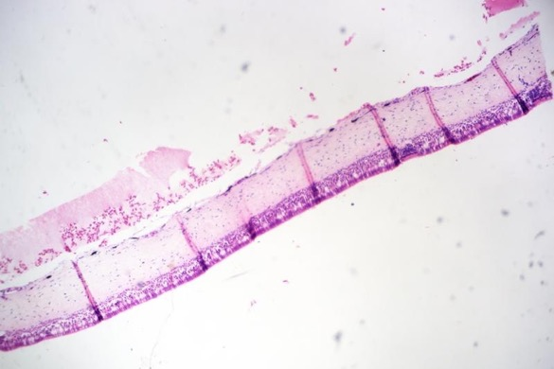
Viral Infection
The airway consists of respiratory tract epithelial cells (below), which are main targets of viruses once inhaled.

Slide 24
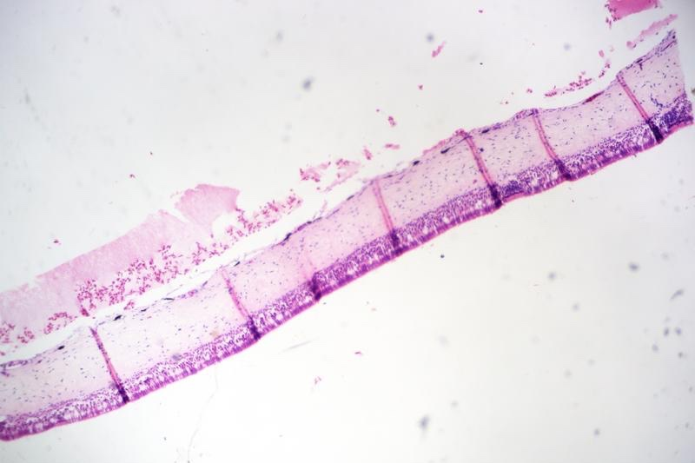
Viral Infection
Once the virus is inside the host’s respiratory system, it can begin infection.

Slide 25
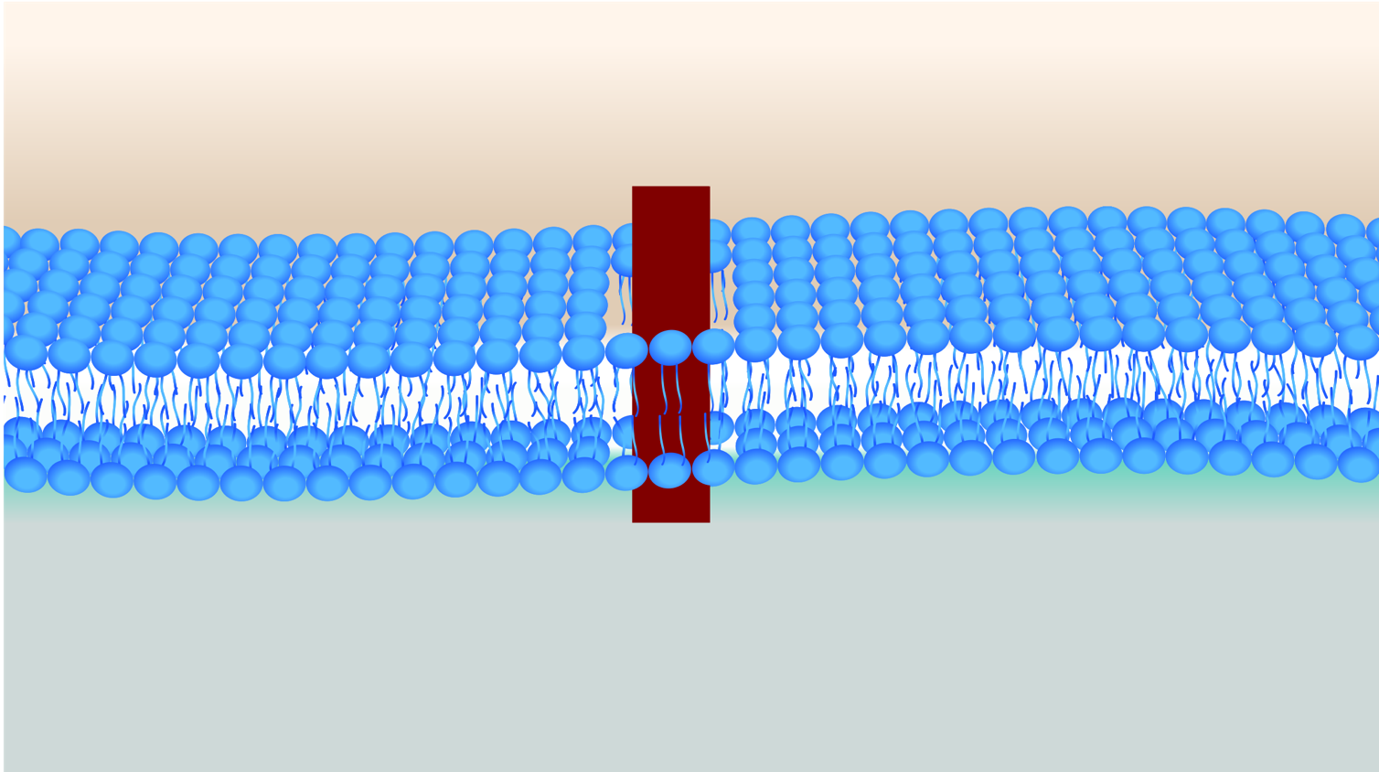
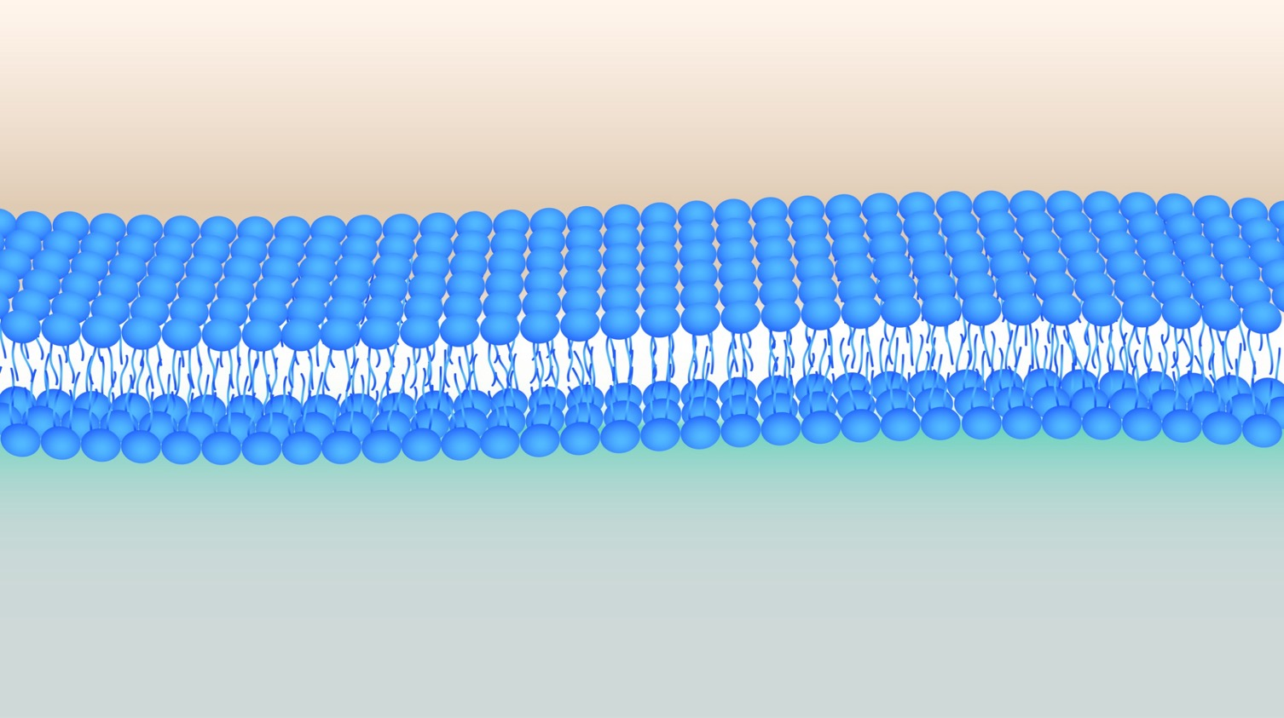
Infection
Stage 1:
ENTRY

Slide 26
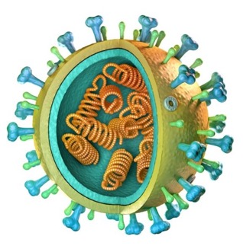
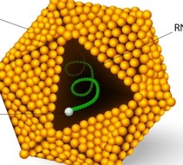
Types of Viruses
Membrane Bound Viruses (COVID-19)
Genetic Material
Each virus has genetic material stored within it, but its mode of entry differs depending on its external layer.
Membrane Layer
Spike Protein
Protein Encased Viruses
Genetic Material
Protein Layer

Slide 27
ENTRY
There are two modes of entry into cells for viruses:
Endocytosis & Membrane Fusion

Slide 28
ENTRY: ENDOCYTOSIS
Cell Membrane
Endocytosis occurs when a viral capsule is engulfed within the cell membrane, forms a vesicle, & advances within.
Cytoplasm

Slide 29
ENTRY: ENDOCYTOSIS
Cell Membrane
Endocytosis occurs when a viral capsule is engulfed within the cell membrane, forms a vesicle, & advances within.
Cytoplasm

Slide 30
ENTRY: ENDOCYTOSIS
Cell Membrane
Endocytosis occurs when a viral capsule is engulfed within the cell membrane, forms a vesicle, & advances within.
Cytoplasm

Slide 31
ENTRY: ENDOCYTOSIS
Cell Membrane
Endocytosis occurs when a viral capsule is engulfed within the cell membrane, forms a vesicle, & advances within.
Cytoplasm

Slide 32
ENTRY: ENDOCYTOSIS
Cell Membrane
Endocytosis occurs when a viral capsule is engulfed within the cell membrane, forms a vesicle, & advances within.
Cytoplasm

Slide 33
ENTRY: ENDOCYTOSIS
Cell Membrane
Endocytosis occurs when a viral capsule is engulfed within the cell membrane, forms a vesicle, & advances within.
Cytoplasm

Slide 34
ENTRY: ENDOCYTOSIS
Cell Membrane
Endocytosis occurs when a viral capsule is engulfed within the cell membrane, forms a vesicle, & advances within.
Cytoplasm

Slide 35
ENTRY: ENDOCYTOSIS
Cell Membrane
Endocytosis occurs when a viral capsule is engulfed within the cell membrane, forms a vesicle, & advances within.
Cytoplasm

Slide 36
ENTRY: ENDOCYTOSIS
Cell Membrane
Endocytosis occurs when a viral capsule is engulfed within the cell membrane, forms a vesicle, & advances within.
Cytoplasm
Endocytosis can occur for both membrane-bound and non-
membrane-bound viruses.

Slide 37
ENTRY: MEMBRANE FUSION
Cell Membrane
Cytoplasm
Membrane fusion occurs when a
membrane-bound virus fuses with host cell membrane and injects genetic material.

Slide 38
ENTRY: MEMBRANE FUSION
Cell Membrane
Cytoplasm
Membrane fusion occurs when a
membrane-bound virus fuses with host cell membrane and injects genetic material.

Slide 39
ENTRY: MEMBRANE FUSION
Cell Membrane
Cytoplasm
Membrane fusion occurs when a
membrane-bound virus fuses with host cell membrane and injects genetic material.

Slide 40
ENTRY: MEMBRANE FUSION
Cell Membrane
Cytoplasm
Membrane fusion occurs when a
membrane bound virus fuses with host cell membrane and injects genetic material.

Slide 41
ENTRY: MEMBRANE FUSION
Cell Membrane
Cytoplasm
Cytoplasm
Membrane fusion occurs when a
membrane-bound virus fuses with host cell membrane and injects genetic material.
Membrane fusion occurs when a
membrane-bound virus fuses with host cell membrane and injects genetic material.

Slide 42
ENTRY: MEMBRANE FUSION
Cell Membrane
Cytoplasm
Cytoplasm
Membrane fusion occurs when a
membrane-bound virus fuses with host cell membrane and injects genetic material.
Membrane fusion occurs when a
membrane-bound virus fuses with host cell membrane and injects genetic material.

Slide 43
ENTRY: MEMBRANE FUSION
Cell Membrane
Cytoplasm
Cytoplasm
Membrane fusion occurs when a
membrane-bound virus fuses with host cell membrane and injects genetic material.
Membrane fusion occurs when a
membrane-bound virus fuses with host cell membrane and injects genetic material.

Slide 44
ENTRY: MEMBRANE FUSION
Cell Membrane
Cytoplasm
Cytoplasm
Membrane fusion can only occur for membrane bound viruses, such as COVID-19.
Membrane fusion occurs when a
membrane-bound virus fuses with host cell membrane and injects genetic material.
Membrane fusion occurs when a
membrane-bound virus fuses with host cell membrane and injects genetic material.

Slide 45
ENTRY: MEMBRANE FUSION
Membrane fusion occurs when a
membrane-bound virus fuses with host cell membrane and injects genetic material.
In COVID-19, this fusion is kickstarted by Spike protein interaction with ACE2 membrane receptor

Slide 46
ENDOCYTOSIS
MEMBRANE FUSION
(Genetic Material)
Cytoplasm
Cytoplasm

Slide 47
Infection
Stage 2:
REPLICATION

Slide 48
There are many different forms of viral genetic material, and each one differs in terms of how it is replicated inside a host cell.
Genetic Material
RNA
DNA
Double Stranded
Single Stranded
Double Stranded
Single Stranded
+ Sense
- Sense

Slide 49

There are many different forms of viral genetic material, and each one differs in terms of how it is replicated inside a host cell.
Genetic Material
RNA
DNA
Double Stranded
Single Stranded
Double Stranded
Single Stranded
+ Sense
- Sense
COVID-19 is a + sense, single stranded RNA virus.

Slide 50
REPLICATION
Once COVID-19 genetic material enters the cell, it can immediately transcribe into
RNA Dependent RNA Polymerase (RDRP).
+ ss RNA
Ribosome
New viral proteins

Slide 51
Ribosome
When translation and protein folding occurs, the RDRP is ready for action.
As a polymerase, RDRP functions to replicate the COVID-19 genetic material.
RDRP

Slide 52
REPLICATION
RDRP build a complimentary - ss RNA strand from the + ss RNA that was injected into the cell.
3'
+ ss RNA
5'

Slide 53
REPLICATION
RDRP build a complimentary - ss RNA strand from the + ss RNA that was injected into the cell.
3'
+ ss RNA
5'

Slide 54
REPLICATION
RDRP build a complimentary - ss RNA strand from the + ss RNA that was injected into the cell.
3'
+ ss RNA
5'

Slide 55
REPLICATION
RDRP build a complimentary - ss RNA strand from the + ss RNA that was injected into the cell.
3'
+ ss RNA
5'

Slide 56
REPLICATION
RDRP build a complimentary - ss RNA strand from the + ss RNA that was injected into the cell.
3'
+ ss RNA
5'
5'

Slide 57
REPLICATION
RDRP build a complimentary - ss RNA strand from the + ss RNA that was injected into the cell.
3'
+ ss RNA
5'
5'

Slide 58
REPLICATION
RDRP build a complimentary - ss RNA strand from the + ss RNA that was injected into the cell.
3'
+ ss RNA
5'
5'

Slide 59
REPLICATION
RDRP build a complimentary - ss RNA strand from the + ss RNA that was injected into the cell.
3'
+ ss RNA
5'

Slide 60
REPLICATION
RDRP build a complimentary - ss RNA strand from the + ss RNA that was injected into the cell.
3'
+ ss RNA
5'
5'
3'

Slide 61
REPLICATION
RDRP build a complimentary - ss RNA strand from the + ss RNA that was injected into the cell.
3'
+ ss RNA
5'
5'
- ss RNA
3'

Slide 62
REPLICATION
5'
- ss RNA
3'
This - ss RNA strand can then build numerous + ss RNA strands for export of new viral particles.

Slide 63
REPLICATION
5'
- ss RNA
3'
3'
+ ss RNA
5'
This - ss RNA strand can then build numerous + ss RNA strands for export of new viral particles.
This - ss RNA strand can then build numerous + ss RNA strands for export of new viral particles.

Slide 64
REPLICATION
Some of the RNA will be translated to produce proteins for the virus. Ribosomes will inject the newly translated proteins into the Rough Endoplasmic Reticulum.

Slide 65
Infection
Stage 3:
SHEDDING

Slide 66
SHEDDING
Viral RNA and proteins form into a vesicle in the RER.
They are then shipped off to the Golgi Apparatus for further modifications
Cytoplasm
Nucleus
Golgi
Apparatus
Rough Endoplasmic
Reticulum

Slide 67
SHEDDING
Viral RNA and proteins form into a vesicle in the RER.
They are then shipped off to the Golgi Apparatus for further modifications
Cytoplasm
Nucleus
Golgi
Apparatus
Rough Endoplasmic
Reticulum

Slide 68
SHEDDING
Viral RNA and proteins form into a vesicle in the RER.
They are then shipped off to the Golgi Apparatus for further modifications
Cytoplasm
Nucleus
Golgi
Apparatus
Rough Endoplasmic
Reticulum

Slide 69
SHEDDING
Viral RNA and proteins form into a vesicle in the RER.
They are then shipped off to the Golgi Apparatus for further modifications
Cytoplasm
Nucleus
Golgi
Apparatus
Rough Endoplasmic
Reticulum

Slide 70
SHEDDING
Viral RNA and proteins form into a vesicle in the RER.
They are then shipped off to the Golgi Apparatus for further modifications
Cytoplasm
Nucleus
Golgi
Apparatus
Rough Endoplasmic
Reticulum

Slide 71
SHEDDING
Viral RNA and proteins form into a vesicle in the RER.
They are then shipped off to the Golgi Apparatus for further modifications.
After that, they are ready for export out of the cell.
Cytoplasm
Nucleus
Golgi
Apparatus
Rough Endoplasmic
Reticulum

Slide 72
SHEDDING
Viruses can exit the cell membrane one of two ways;
Exocytosis
or
Membrane Budding
Cytoplasm
Nucleus
Golgi
Apparatus
Rough Endoplasmic
Reticulum

Slide 73
SHEDDING
(EXOCYTOSIS)
Exocytosis allows the vesicle to absorb into the cell membrane, then allowing the virus to exit.
This is a common mode of exit for viruses that lack a cell membrane.
Cytoplasm
Nucleus
Golgi
Apparatus
Rough Endoplasmic
Reticulum

Slide 74
SHEDDING
(EXOCYTOSIS)
Cytoplasm
Cytoplasm
Nucleus
Nucleus
Golgi
Apparatus
Golgi
Apparatus
Rough Endoplasmic
Reticulum
Rough Endoplasmic
Reticulum

Slide 75
SHEDDING
(EXOCYTOSIS)
Cytoplasm
Cytoplasm
Nucleus
Nucleus
Golgi
Apparatus
Golgi
Apparatus
Rough Endoplasmic
Reticulum
Rough Endoplasmic
Reticulum

Slide 76
SHEDDING
(EXOCYTOSIS)
Cytoplasm
Cytoplasm
Nucleus
Nucleus
Golgi
Apparatus
Golgi
Apparatus
Rough Endoplasmic
Reticulum
Rough Endoplasmic
Reticulum

Slide 77
SHEDDING
(EXOCYTOSIS)
Cytoplasm
Cytoplasm
Nucleus
Nucleus
Golgi
Apparatus
Golgi
Apparatus
Rough Endoplasmic
Reticulum
Rough Endoplasmic
Reticulum

Slide 78
SHEDDING
(MEMBRANE BUDDING)
If it does require an outer membrane envelope, like COVID-19, membrane
budding occurs:
The membrane budding process allows the viral capsid to utilize some of the cell membrane for itself
Cytoplasm
Nucleus
Golgi
Apparatus
Rough Endoplasmic
Reticulum

Slide 79
SHEDDING
(MEMBRANE BUDDING)
Cytoplasm
Nucleus
Golgi
Apparatus
Rough Endoplasmic
Reticulum

Slide 80
SHEDDING
(MEMBRANE BUDDING)
Cytoplasm
Nucleus
Golgi
Apparatus
Rough Endoplasmic
Reticulum

Slide 81
SHEDDING
(MEMBRANE BUDDING)
Cytoplasm
Nucleus
Golgi
Apparatus
Rough Endoplasmic
Reticulum

Slide 82
SHEDDING
(MEMBRANE BUDDING)
Cytoplasm
Nucleus
Golgi
Apparatus
Rough Endoplasmic
Reticulum

Slide 83
EXOCYTOSIS
MEMBRANE BUDDING
(Genetic Material)
Cytoplasm
Cytoplasm

Slide 84
COVID-19 virus particles, after undergoing membrane budding, have specific glycoproteins embedded within their membrane.
These are the SPIKE proteins, and are integral to how COVID-19 can infect, but also how we can protect against infection.

Slide 85
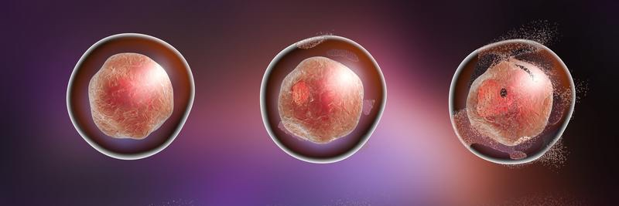
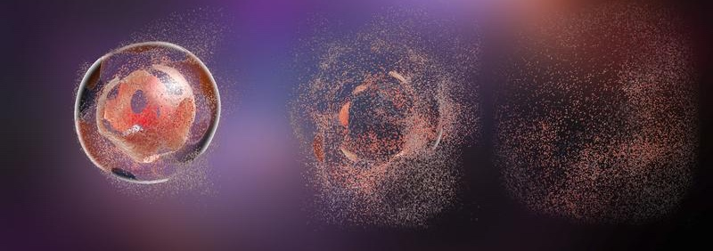
SHEDDING
(CELL DESTRUCTION)
Finally, viral shedding also can occur as a byproduct of cell destruction. Cell destruction occurs as an immune response to the viral
Infection.

Slide 86
SHEDDING
(CELL DESTRUCTION)
Cellular apoptosis shuts down given cell as a virus-replication factory, but will also result in the release of any final virus capsids that are still inside.

Slide 87
Illness and Symptoms
After shedding, the viral capsules
go off into the host’s other cells
to continue the infection process.
When infection occurs on a large
scale throughout the host’s systems,
the immune system kicks into overdrive.

Slide 88

Illness and Symptoms
Symptoms of infections include cough, diarrhea, and vomiting.
A fever, though uncomfortable and sometime even life threatening, is actually an immune response. Viruses can be particularly susceptible to elevated “environmental” temperatures.

Slide 89
Next Time…
How can we kill viruses, and what impact does combating viruses have on our own human cells?

Slide 90
Virus Biology & Evolution
The Case of COVID-19
3.
Killing a Virus

Slide 91
How do certain chemicals destroy viruses?
What is the effect of these chemicals on our own cells?

Slide 92
Learning Objectives
Students should be able to:
Compare and contrast various mechanisms of hand sanitizer, soap, and bleach in destroying pathogens
Describe the effects of these chemicals and detergents on our own skin cells
Be able to differentiate what type of viruses can evade certain chemicals / detergents and why they hold that ability

Slide 93

Killing Viruses
It is very common to see hand sanitizer stations, disinfecting wipes, and hand-washing signs especially during the winter months when sickness and colds are prevalent.
But… how do these type of products protect us against viruses?

Slide 94

Hand Sanitizer
What makes hand sanitizer
destructive to viruses?

Slide 95
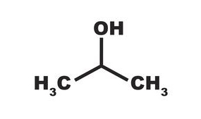
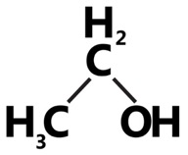
Hand Sanitizer
Most hand sanitizer contains
isopropyl alcohol and ethanol alcohol. Both of these can disrupt cell membranes.

Slide 96
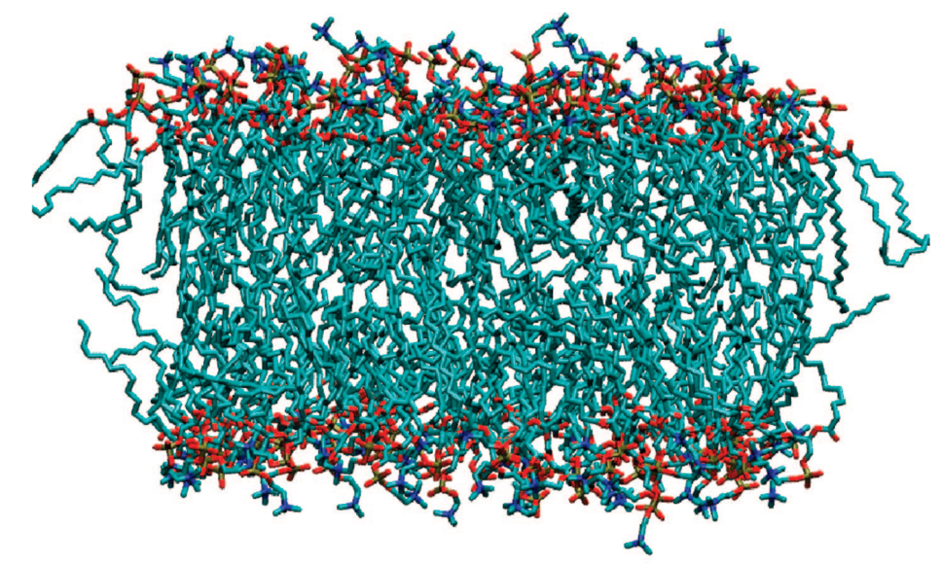
Hand Sanitizer
The alcohols are able to permeate into the phospholipid bilayer membrane and break it apart, essentially rupturing it.
Gurtovenko, A. A., & Anwar, J. (2009). Interaction of ethanol with biological membranes: the formation of non-bilayer structures within the membrane interior and their significance. The journal of physical chemistry B, 113(7), 1983-1992.

Slide 97
Hand Sanitizer
This model from Gurtovenko & Anwar (2009) illustrates the effects of ethanol.
Pictured is a membrane:
Gurtovenko, A. A., & Anwar, J. (2009). Interaction of ethanol with biological membranes: the formation of non-bilayer structures within the membrane interior and their significance. The journal of physical chemistry B, 113(7), 1983-1992.

Slide 98
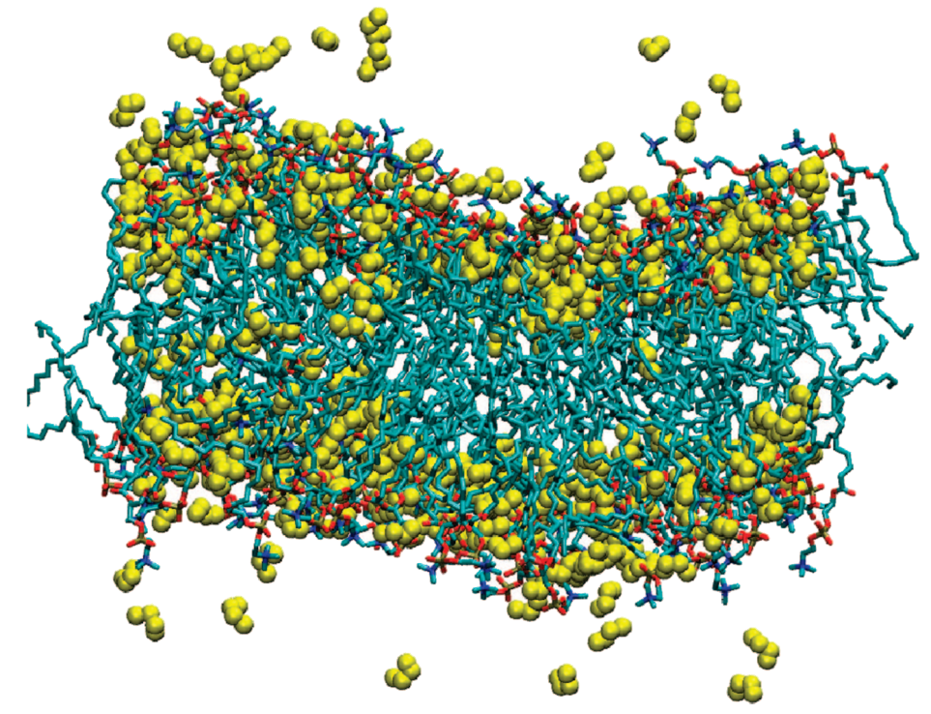
Hand Sanitizer
And this is that
membrane after
treatment with
ethanol.
Gurtovenko, A. A., & Anwar, J. (2009). Interaction of ethanol with biological membranes: the formation of non-bilayer structures within the membrane interior and their significance. The journal of physical chemistry B, 113(7), 1983-1992.

Slide 99
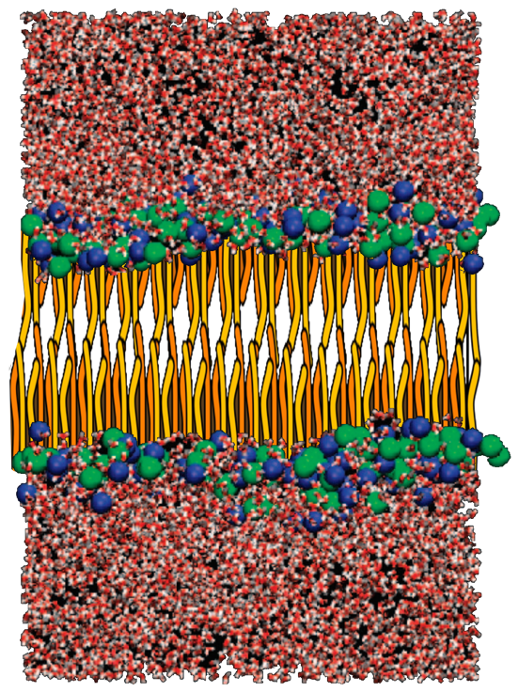
Hand Sanitizer
Water
A similar model shows a membrane with water on either side.
Membrane
Layer
Water
Gurtovenko, A. A., & Anwar, J. (2009). Interaction of ethanol with biological membranes: the formation of non-bilayer structures within the membrane interior and their significance. The journal of physical chemistry B, 113(7), 1983-1992.

Slide 100
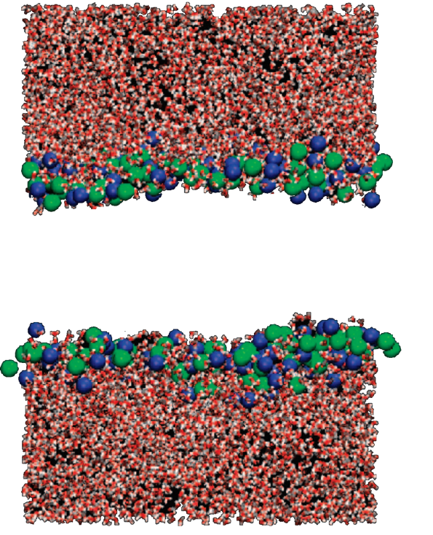
Hand Sanitizer
Water
The lipids have been removed from the model for clarity, but it’s still an intact membrane.
Membrane
Layer
Water
Gurtovenko, A. A., & Anwar, J. (2009). Interaction of ethanol with biological membranes: the formation of non-bilayer structures within the membrane interior and their significance. The journal of physical chemistry B, 113(7), 1983-1992.

Slide 101
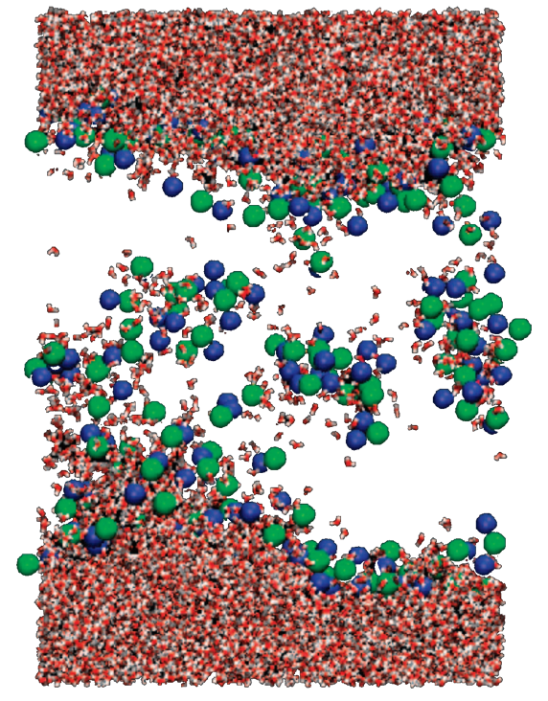
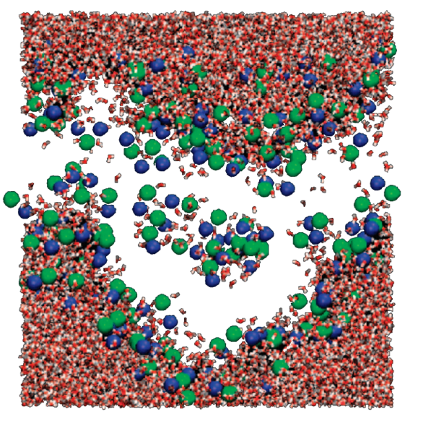
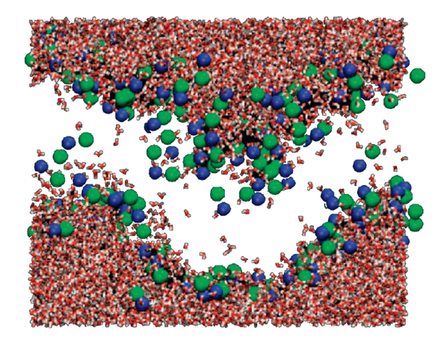
Hand Sanitizer
That is, until the ethanol is added.
Then the separation bursts apart.
Gurtovenko, A. A., & Anwar, J. (2009). Interaction of ethanol with biological membranes: the formation of non-bilayer structures within the membrane interior and their significance. The journal of physical chemistry B, 113(7), 1983-1992.
Notes:
Addition of ethanol. Takes 30,000 picoseconds

Slide 102
Hand Sanitizer
Ethanol is a small, uncharged molecule. Due to this, it can incorporate within phospholipid bilayer membranes.
H
H
O
C
H
C
H
H
H

Slide 103
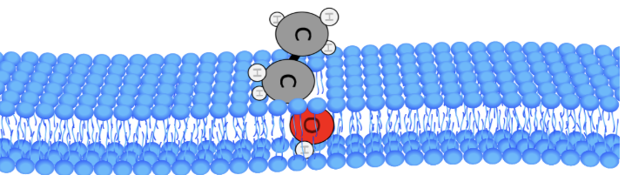
Ethanol is a small, uncharged molecule. Due to this, it can incorporate within phospholipid bilayer membranes.
*Ethanol size increased in magnitude for illustrative purposes only. Not true to size.

Slide 104
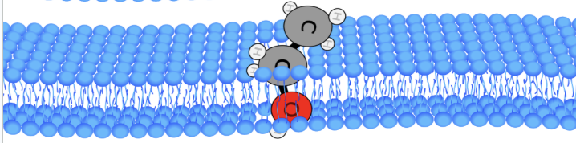
Ethanol is a small, uncharged molecule. Due to this, it can incorporate within phospholipid bilayer membranes.
*Ethanol size increased in magnitude for illustrative purposes only. Not true to size.

Slide 105
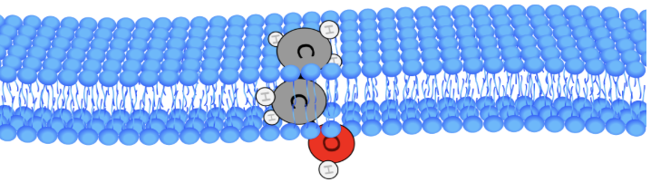
Ethanol is a small, uncharged molecule. Due to this, it can incorporate within phospholipid bilayer membranes.
*Ethanol size increased in magnitude for illustrative purposes only. Not true to size.

Slide 106
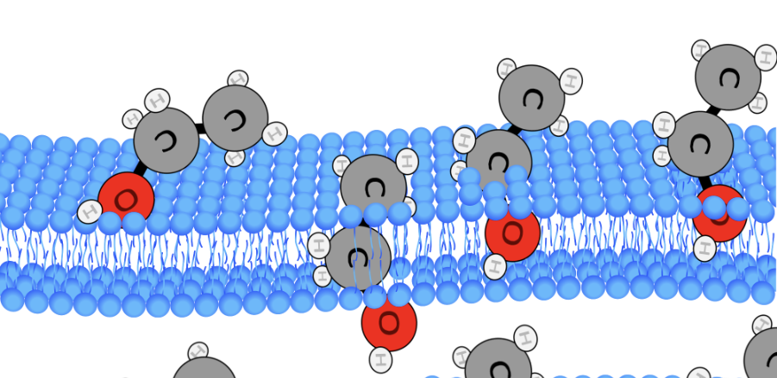
When large amounts of ethanol are present, they disrupt the lipids, and the membrane loses its structure.
*Ethanol size increased in magnitude for illustrative purposes only. Not true to size.

Slide 107
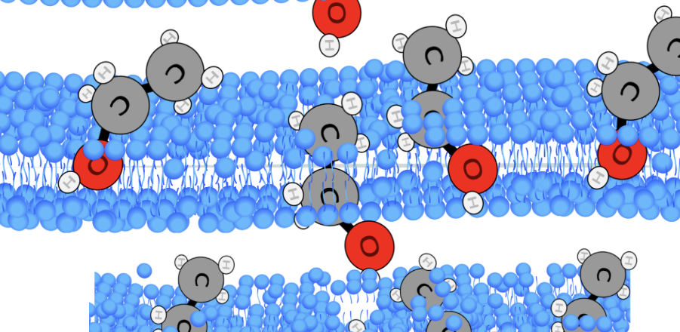
When large amounts of ethanol are present, they disrupt the lipids, and the membrane loses its structure.
*Ethanol size increased in magnitude for illustrative purposes only. Not true to size.

Slide 108
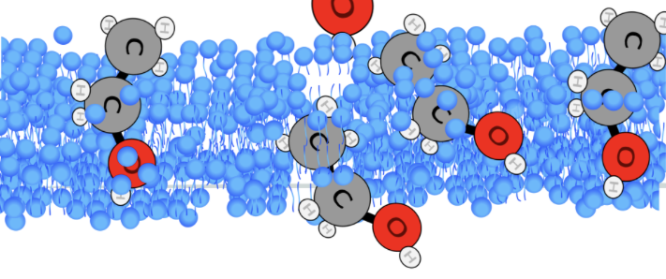
When large amounts of ethanol are present, they disrupt the lipids, and the membrane loses its structure.
*Ethanol size increased in magnitude for illustrative purposes only. Not true to size.

Slide 109
Ethanol is most effective when at 90% concentration & above.
*Ethanol size increased in magnitude for illustrative purposes only. Not true to size.

Slide 110
Hand Sanitizer
H
H
H
C
H
C
O
H
H
C
H
O
H
H
C
C
O
H
H
H
H
H
C
H
O
H
H
H
C
H
H
H
H
H
H
H
C
H
H
C
H
O
H
H
C
H
O
H
H
C
C
O
H
EtOH
H
H
C
H
H
H
C
H
H
H
This disrupts the gradients present in the cell and denatures it. This is why hand sanitizer is a effective treatment for viruses that are encased within a membrane, such as COVID19, or influenza.

Slide 111

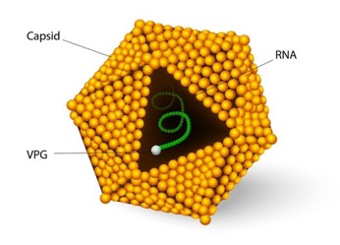
Hand Sanitizer
However, this renders Hand Sanitizer unable to protect against viruses that are not encapsulated within a cell membrane, such as rhinovirus, norovirus, and Hepatitis A.
EFFECTIVE
INEFFECTIVE

Slide 112
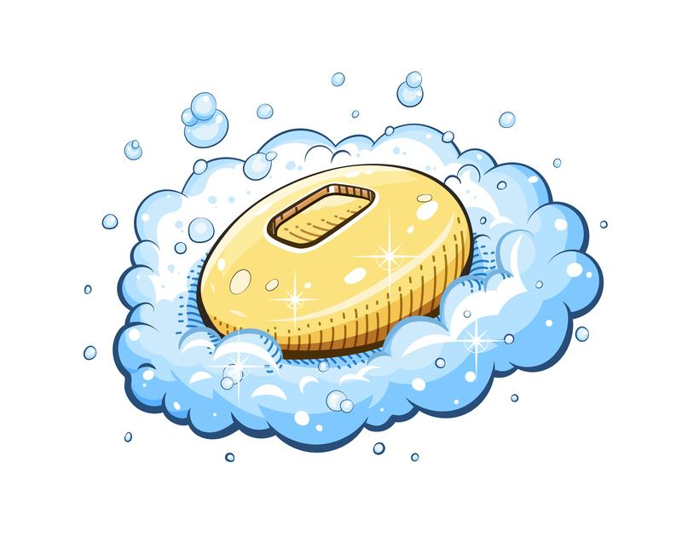
Soap
Soap is also capable of destroying plasma membranes of viruses, in a similar fashion to hand sanitizer.

Slide 113
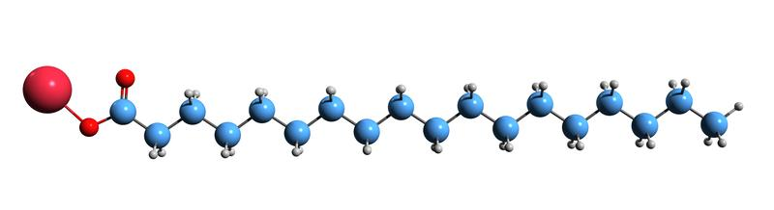
Soap
Many soaps contains a molecule called sodium stearate.

Slide 114

Soap
Sodium stearate bears a striking resemblance to a phospholipid; it too has a hydrophilic head and a hydrophobic tail.

Slide 115

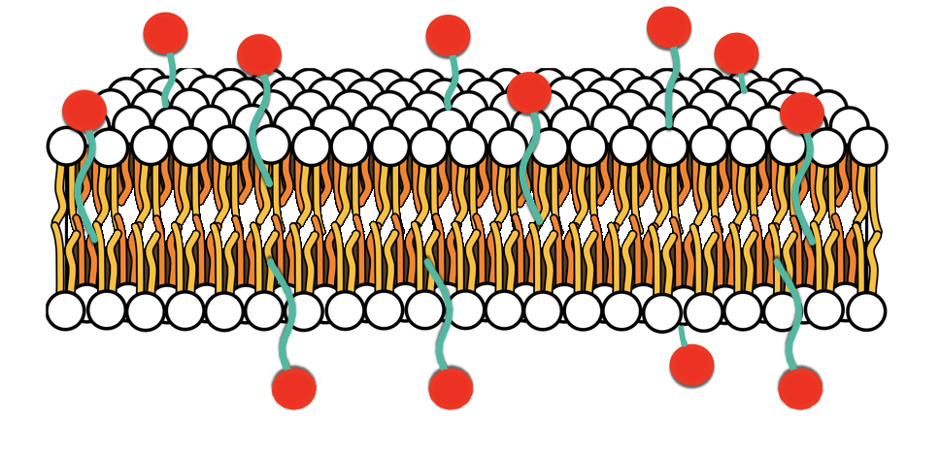
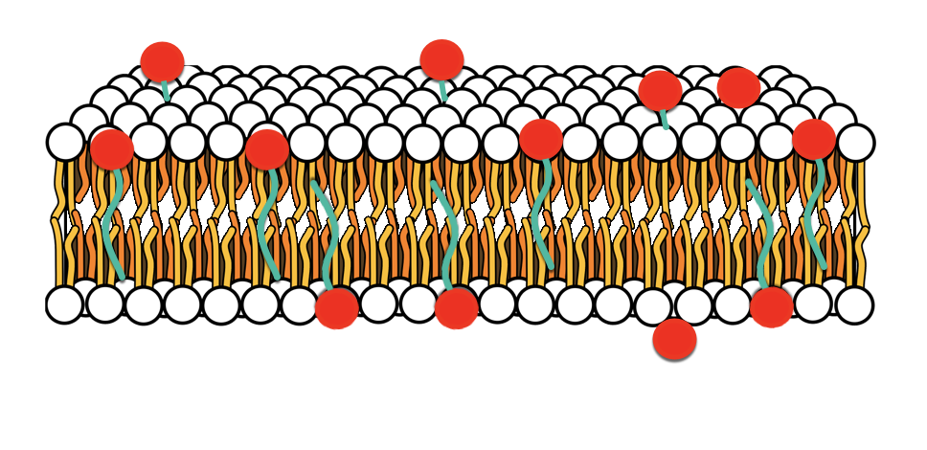
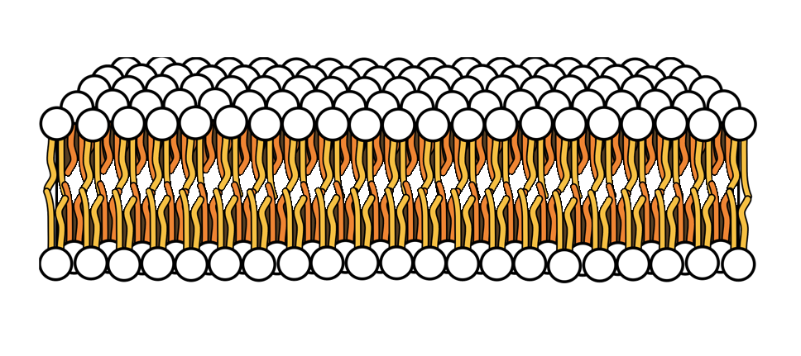
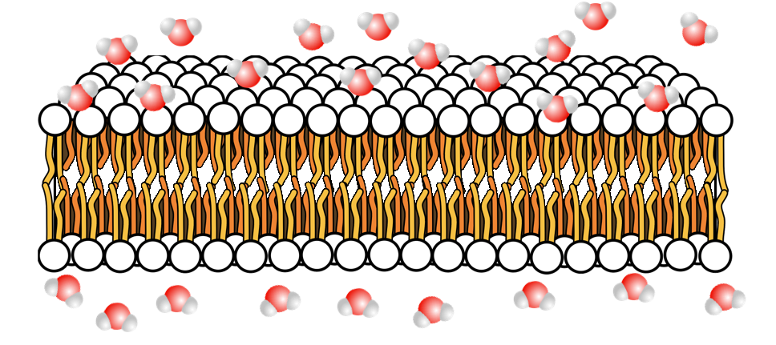
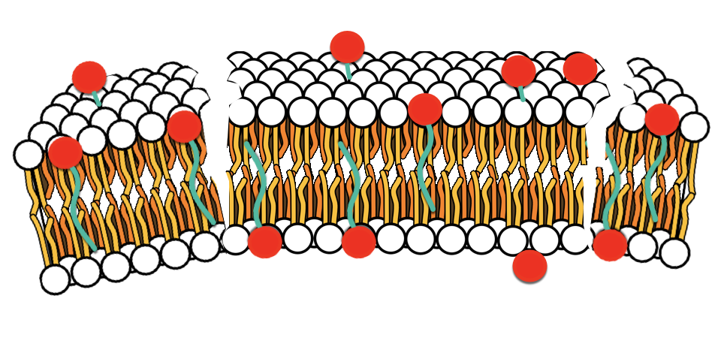
Soap
Due to this conformation, Sodium stearate is able to integrate and dissolve the cell membrane similar to Ethanol and Isopropyl alcohol.
Phospholipid image from: https://www.ck12.org/chemistry/phospholipids/lesson/Phospholipids-CHEM/

Slide 116
Cell Membrane
Recall COVID-19 gains entry into cells by SPIKE protein and ACE2 receptor interaction.
Cytoplasm

Slide 117
Cell Membrane
Recall COVID-19 gains entry into cells by SPIKE protein and ACE2 receptor interaction.
Cytoplasm

Slide 118
Cell Membrane
Recall COVID-19 gains entry into cells by SPIKE protein and ACE2 receptor interaction.
Cytoplasm

Slide 119
Cell Membrane
Cytoplasm
Recall COVID-19 gains entry into cells by SPIKE protein and ACE2 receptor interaction.
Cytoplasm
Recall COVID-19 gains entry into cells by SPIKE protein and ACE2 receptor interaction.

Slide 120
Cell Membrane
Cytoplasm
Recall COVID-19 gains entry into cells by SPIKE protein and ACE2 receptor interaction.
Cytoplasm
Recall COVID-19 gains entry into cells by SPIKE protein and ACE2 receptor interaction.

Slide 121
Cell Membrane
If soap removes the virus membrane along with its associated proteins, then it can’t enter the cell.
Cytoplasm

Slide 122
Cell Membrane
If soap removes the virus membrane along with its associated proteins, then it can’t enter the cell.
Cytoplasm

Slide 123
Cell Membrane
If soap removes the virus membrane along with its associated proteins, then it can’t enter the cell.
Cytoplasm

Slide 124
Cell Membrane
If soap removes the virus membrane along with its associated proteins, then it can’t enter the cell.
Cytoplasm

Slide 125
Cell Membrane
If soap removes the virus membrane along with its associated proteins, then it can’t enter the cell.
Cytoplasm

Slide 126
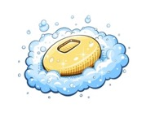
Soap
Soap is similar to Hand Sanitizer. It isn’t directly able to protect against viruses lacking a cell membrane… but the act of washing hands thoroughly could lead to viruses being literally washed off of the skin.
EFFECTIVE
INDIRECTLY
EFFECTIVE

Slide 127



Soap & Hand Sanitizer Effects on the Skin
If the molecules in hand sanitizer and soaps can damage viral cell membranes, why don’t they harm our skin in the same way?

Slide 128
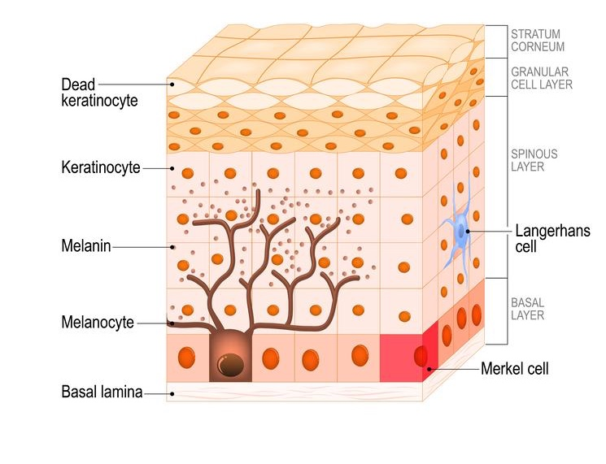
Soap & Hand Sanitizer Effects on the Skin
The outermost layer of our skin is composed of dead cells, known as ‘dead keratinocyte’.
While having dead skin may not
sound like a good thing, this layer protects our skin from infections and environmental elements that might otherwise infect or damage our cells.

Slide 129
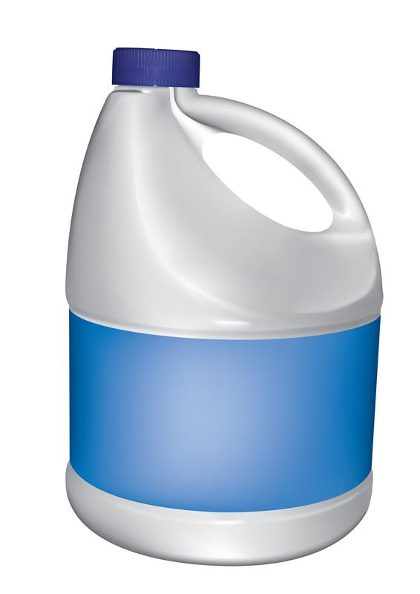
Bleach
Bleach is another chemical that can damage and destroy viruses.

Slide 130
Bleach
Bleach contains Sodium Hypochlorite, which when
dissolved in water forms
Hypochlorous Acid.
H2O
Na - O - Cl + H Cl - OH + Na

Slide 131
Bleach
Bleach contains Sodium Hypochlorite, which when
dissolved in water forms
Hypochlorous Acid.
H2O
Na - O - Cl + H Cl - OH + Na

Slide 132
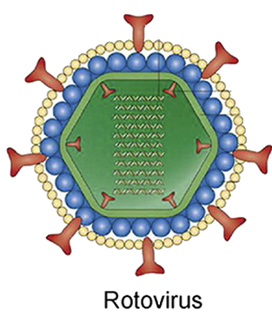
membrane envelope
Hypochlorous acid can denature proteins and thus can critically damage the membrane features of viral capsids.
protein capsid
Adapted from: Altintas, Z., Gittens, M., Pocock, J., & Tothill, I. E. (2015). Biosensors for waterborne viruses: Detection and removal. Biochimie, 115, 144-154.

Slide 133
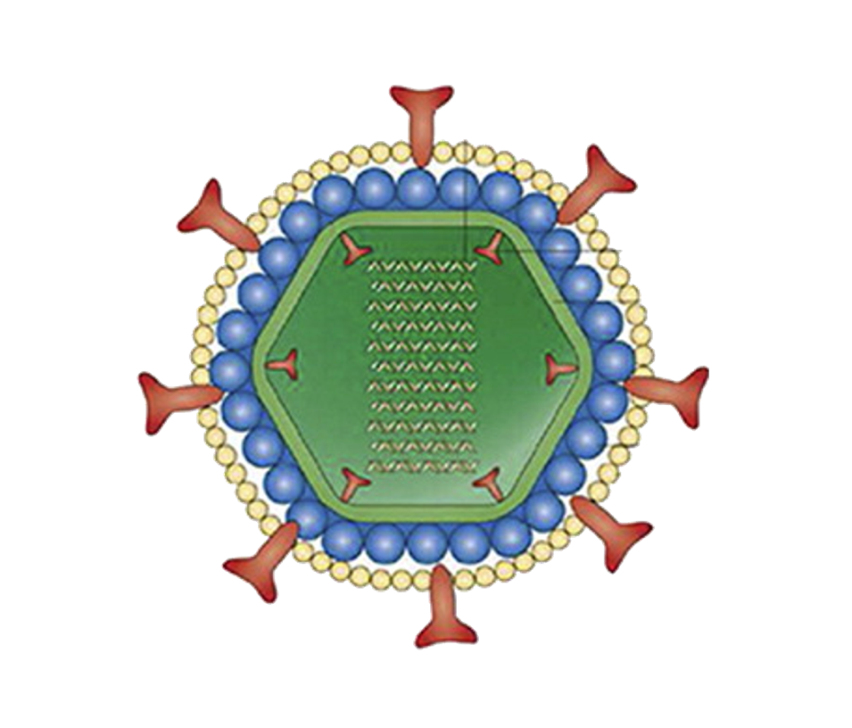
Adapted from: Altintas, Z., Gittens, M., Pocock, J., & Tothill, I. E. (2015). Biosensors for waterborne viruses: Detection and removal. Biochimie, 115, 144-154.

Slide 134
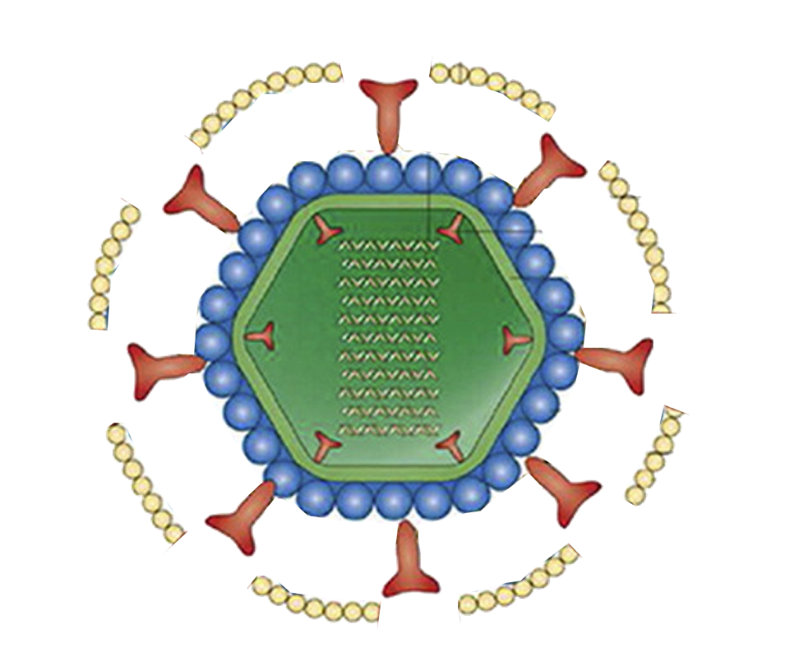
Adapted from: Altintas, Z., Gittens, M., Pocock, J., & Tothill, I. E. (2015). Biosensors for waterborne viruses: Detection and removal. Biochimie, 115, 144-154.

Slide 135
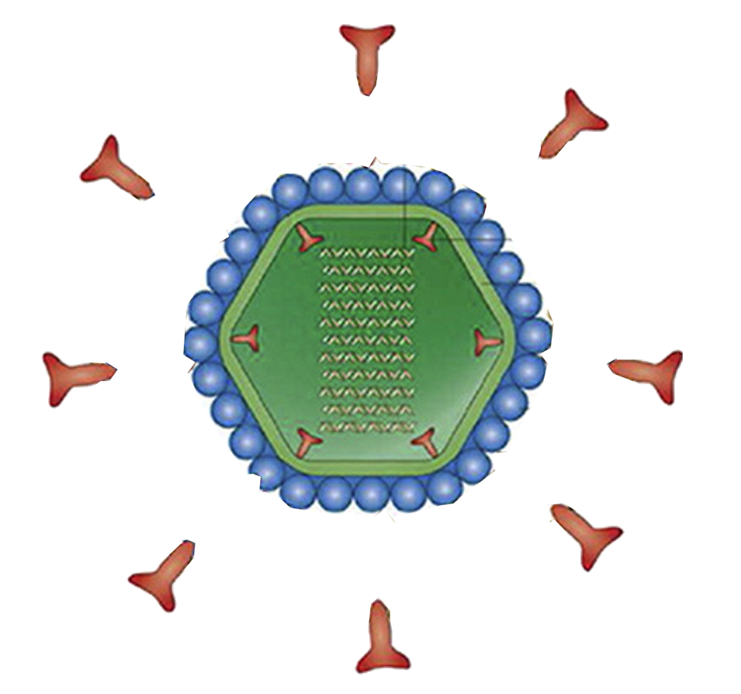
Adapted from: Altintas, Z., Gittens, M., Pocock, J., & Tothill, I. E. (2015). Biosensors for waterborne viruses: Detection and removal. Biochimie, 115, 144-154.

Slide 136
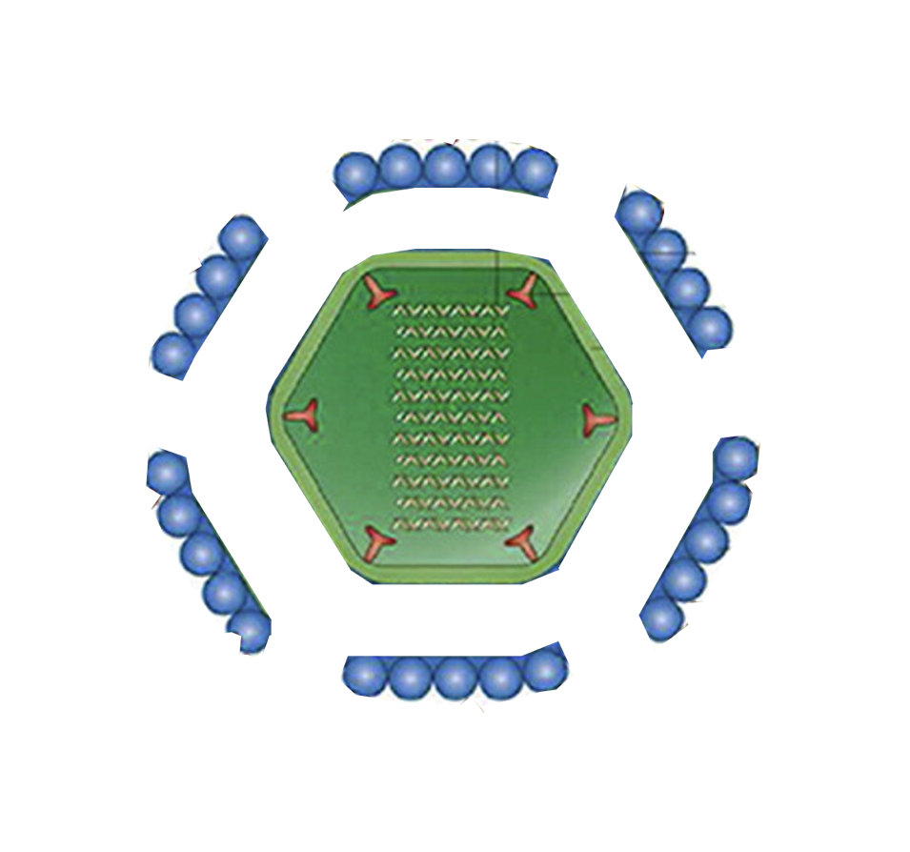
Adapted from: Altintas, Z., Gittens, M., Pocock, J., & Tothill, I. E. (2015). Biosensors for waterborne viruses: Detection and removal. Biochimie, 115, 144-154.

Slide 137


Adapted from: Altintas, Z., Gittens, M., Pocock, J., & Tothill, I. E. (2015). Biosensors for waterborne viruses: Detection and removal. Biochimie, 115, 144-154.

Slide 138
Bleach
Cl - OH
Cl - OH
Hypochlorous acid can denature proteins and thus can critically damage the membrane features of viral capsids.
Cl - OH
Cl - OH
Cl - OH

Slide 139
Bleach
Cl - OH
Cl - OH
If the acid denatures the virus spike proteins, it is unable to access host cells.
Cl - OH
Cl - OH
Cl - OH

Slide 140
Bleach
Cl - OH
Cl - OH
The protein-destroying nature of bleach means that it can also destroy virus capsids lacking a membrane.
Cl - OH
Cl - OH
Cl - OH

Slide 141
Bleach
Cl - OH
Cl - OH
The protein-destroying nature of bleach means that it can also destroy virus capsids lacking a membrane.
Cl - OH
Cl - OH
Cl - OH

Slide 142

Bleach
Bleach’s ability to denature proteins makes it an ideal agent to destroy viruses of all types.
EFFECTIVE
EFFECTIVE

Slide 143
Bleach
Cl - OH
Cl - OH
This ability to disrupt and destroy proteins makes bleach a VERY dangerous chemical to encounter. Bleach can cause serious damage to the skin and internal organs.
Cl - OH
Cl - OH
Cl - OH

Slide 144

Bleach
Bleach is MUCH, MUCH more dangerous than either hand sanitizer or soap to the skin and the insides of the body if ingested.
POISONOUS

Slide 145
Next Time…
Overview of the mechanisms in which the body can defend itself against viruses with its immune system

Slide 146
Virus Biology & Evolution
The Case of COVID-19
4.
The Immune System’s Defense Against Viruses

Slide 147
How does the immune system recognize and defend against viruses?
Why do we sometimes become infected with a virus twice?

Slide 148
Learning Objectives
Students should be able to:
Write and describe the order of events an immune system uses to defend against viruses
Describe both the structure and function of antibodies as well as B cells, including their relationship to each other
Describe how a virus can be defended against without being encountered before, as well as how a person can become infected with a virus they have previously contracted

Slide 149

B Cells
B Cells are an integral component of the body’s immune system.

Slide 150

B Cells
The importance of B cells is their ability to produce antibodies within the membrane of the cell.
Antibody

Slide 151

The Antibody
The antibody is a protein produced in the B cell, which is then transported to the membrane.
Protein
mRNA
DNA
Translation
Transcription

Slide 152
The Antibody
There are two components to the antibody; the constant region and the variable region.
The variable region is different for every single type of antibody; making each antibody incredibly specific.
VARIABLE
CONSTANT
Protein
mRNA
DNA
Translation
Transcription

Slide 153




The Antibody
Antibodies typically can only bind to a specific virus.

Slide 154
The Antibody
Antibodies typically can only bind to a specific virus.

Slide 155

The Antibody
Once embedded in the membrane, some of the antibodies are secreted into circulation, to defend the host from viruses.
Others remain embedded into the B cell.

Slide 156






The Antibody
The antibodies entering circulation, along with the antibodies still embedded within the B cell play significant roles in the immune system’s ability to respond to infection.

Slide 157
Infection
When the body is infected with a virus it hasn’t come into contact with before, there won’t be any antibodies. Once exposed, the immune system will begin to build new antibodies.

Slide 158
Infection
This occurs by systematic scrambling of DNA within the B cells, which randomly changes the shape of antibodies to try and fit the new virus.
DNA
SCRAMBLE
NEW
DNA

Slide 159


Infection
Once scrambled, the modified DNA is transcribed and translated, resulting in a newly shaped protein.
transcription
TRANSLATION
transcription
TRANSLATIoN

Slide 160
Infection
If this seems too random of a process to be able to develop an antibody efficiently, consider the vast number of antibody producing B cells.

Slide 161
Infection
Estimates of 10 Billion B cells reside in a healthy body.
each of which kicked into overdrive to develop an antibody
to target a new virus

Slide 162

Infection
Estimates of 10 Billion B cells reside in a healthy body.
each of which kicked into overdrive to develop an antibody
to target a new virus

Slide 163


Recall that some antibodies are secreted into circulation while others remain lodged in the B cell. When the host is exposed to a virus, it is bombarded by freely circulating antibodies.

Slide 164

The antibody binding to the virus and blocking its spike protein renders the virus unable to gain entry to host cells. This way it can no longer infect and replicate.
The binding of the antibody also signals for the degradation and destruction of the virus.

Slide 165


At the same time, when a virus attaches to an antibody still embedded in the B cell, a series of reactions occur to stimulate the production of two new B cells.

Slide 166




Differentiation of the original B cell signals for the production of two new types of B cells:
Plasma B Cells
&
Memory B Cells
PLASMA
B CELL
MEMORY
B CELL

Slide 167







B CELL
ACTIVATION
VIRUS
B CELL
SPIKE
PROTEIN
ANTIBODIES
MEMORY
B CELL
PLASMA
B CELL

Slide 168


Plasma B Cells
Plasma B cells function to produce mass levels of antibodies to be secreted into the blood, to bombard and neutralize a present pathogen.
PLASMA
B CELL

Slide 169

Once the antibodies are released from Plasma B cells and the virus is eliminated from the host, Plasma B cells die.

Slide 170

Memory B Cells
Memory B Cells serve as a reservoir for future need, if exposed again.
MEMORY
B CELL

Slide 171

Once the virus is eliminated from the host, Memory B cells are stored away in bone marrow, the spleen, and lymphs in case of a future infection.

Slide 172
Repeated Illness
If Memory B Cells serve as a database and can be reactivated for future infection, why is it some people can get sick with the same virus more than once?
MEMORY
B CELL

Slide 173
Repeated Illness
Sometimes Memory B cells aren’t produced, or have a shorter lifespan than normal.
MEMORY
B CELL

Slide 174

Repeated Illness
But sometimes, with viruses with a high mutation rate, the antibodies created aren’t specific any longer.
And thus, the cycle begins again.

Slide 175
Next Time…
Function and mechanism of a vaccine, along with how it related to the COVID pandemic

Slide 176
Virus Biology & Evolution
The Case of COVID-19
5.
COVID-19 & The COVID-19 Vaccine

Slide 177
How does a vaccine work?
Why is a vaccine necessary?

Slide 178
Learning Objectives
Describe the effect of a vaccine and how it aids in immunity from viruses
Describe the mechanism of an mRNA vaccine specifically
Be able to explain why a vaccine is necessary for an individual who already has a functioning immune system

Slide 179


The Immune Response
As previously discussed, upon infection with a virus, the body mounts a vital mission to creating an antibody to neutralize the attack.
transcription
TRANSLATION
transcription
TRANSLATIoN

Slide 180

The Immune Response
And while this process is natural and often works, sometimes a virus has a detrimental effect before the immune system is able to properly initiate a heightened defense.

Slide 181

COVID - 19
In 2020, SARS-CoV-2 (COVID-19) became recognized.
After the W.H.O. declared a global health pandemic, every facet of the world was impacted by the shutdown and quarantine that followed.
The year of 2020 saw 1.5 million deaths, 2021 saw over 5 million

Slide 182









COVID - 19
In 2020, Sars-cov-2 (COVID-19) became recognized.
After the W.H.O. declared a global health pandemic, every facet of the world was impacted by the shutdown and quarantine that followed.
The year of 2020 saw 1.5 million deaths, 2021 saw over 5 million

Slide 183


Government Response
As a response to the global pandemic, The United States Government initiated
OPERATION WARPSPEED,
a program with the mission to create a vaccine against COVID-19.

Slide 184

Vaccine Composition
But… what is it?

Slide 185

Vaccine Composition
The Covid-19 Vaccine
is an mRNA vaccine,
encapsulated in a lipid membrane

Slide 186

Vaccine Composition
This specific mRNA is derived from the COVID-19 genome, particularly the gene that encodes for the COVID-19 virus spike protein
TRANSLATION

Slide 187
Vaccine
Vaccine Composition
Recall that the spike protein is what grants the virus entry into a cell.
Also note that the spike protein itself is not harmful, only when it functions to allow viruses into cells does it become problematic.

Slide 188


Vaccine Mechanism
Since the spike protein is not harmful,
no harm is caused when it is injected
into the body

Slide 189

Vaccine
Vaccine Mechanism
Once the mRNA from the vaccine is introduced to the body, it enters cells via membrane fusion.
The mRNA acts as a code, which the ribosomes read and generate a spike protein through translation.
mRNA
TRANSLATION
SPIKE
PROTEIN

Slide 190

Vaccine
Vaccine Mechanism
Again following instructions, these new spike proteins are embedded into the cell’s membrane.
This stimulates the immune system, which sees the spike proteins as foreign bodies.

Slide 191



Vaccine Mechanism
transcription
TRANSLATIoN
From this point, the immune response is the same as it was for the pathogen but there is no negative effects of infection

Slide 192
Vaccine Mechanism
transcription
TRANSLATIoN

Slide 193
Vaccine Mechanism
This way, all the benefits of an immune reaction, including defense response and memory storage are maintained,
while the detrimental and pathogenic illness is actually evaded.
This way when one is infected, they already have the antibody manufactured and ready for distribution.
PLASMA
B CELL
MEMORY
B CELL

Slide 194
To Recap…
The Spike Protein is the key to understanding membrane bound viruses, such as COVID-19

Slide 195

To Recap…
It is the mechanism in which viruses are capable of entering cells, allowing infection to then occur

Slide 196



To Recap…
Due to this, if a spike protein is inhibited or degraded the virus loses ability to infect and replicate

Slide 197

To Recap…
And when the spike protein is recognized, the immune system is able to trigger a specialized response

Slide 198

To Recap…
This response can also be initiated without infection, through the injection of isolated spike proteins via vaccination

Slide 199
To Recap…
Ultimately, viruses can be dangerous and lead to serious and detrimental effects. Vaccines are a safe and effective way to mitigate potential harm a virus may cause.

Slide 200
To Recap…
While vaccine side effects have been documented, these occurrences are rare and are far outweighed by the benefit of vaccination
For more information, visit CDC.gov

